Slide 1
7COM1079-2022 Student Group ID:
1
We are using the dataset DS153 data_0 Star.csv to answer our Research question “Is there a difference in the mean of verified between primary_time seconds?”
Id | Real_time_seconds | Primary_time_seconds | Verified
m3krj5dy | 376.6 | 376.6 | Yes
ydl4l90z | 386 | 386 | Yes
ywjg8w9z | 387.38 | 387.38 | Yes
ydjw8wvy | 388.13 | 388.13 | Yes
zpx4ljxm | 389.58 | 389.58 | Yes
zpx5v9rm | 391 | 391 | Yes
mr988ogm | 392.15 | 392.15 | Yes
y6qdo8pz | 393.1 | 393.1 | Yes
y2jpjn9z | 393.25 | 393.25 | Yes
m7okp14y | 397.06 | 397.06 | Yes
y2221wjy | 400.45 | 400.45 | Yes
The sample of the dataset is given.
The dataset has 303 rows and 11 columns
The dependent variable is Verified
The independent variable is real_time seconds
Notes:
1

Slide 2
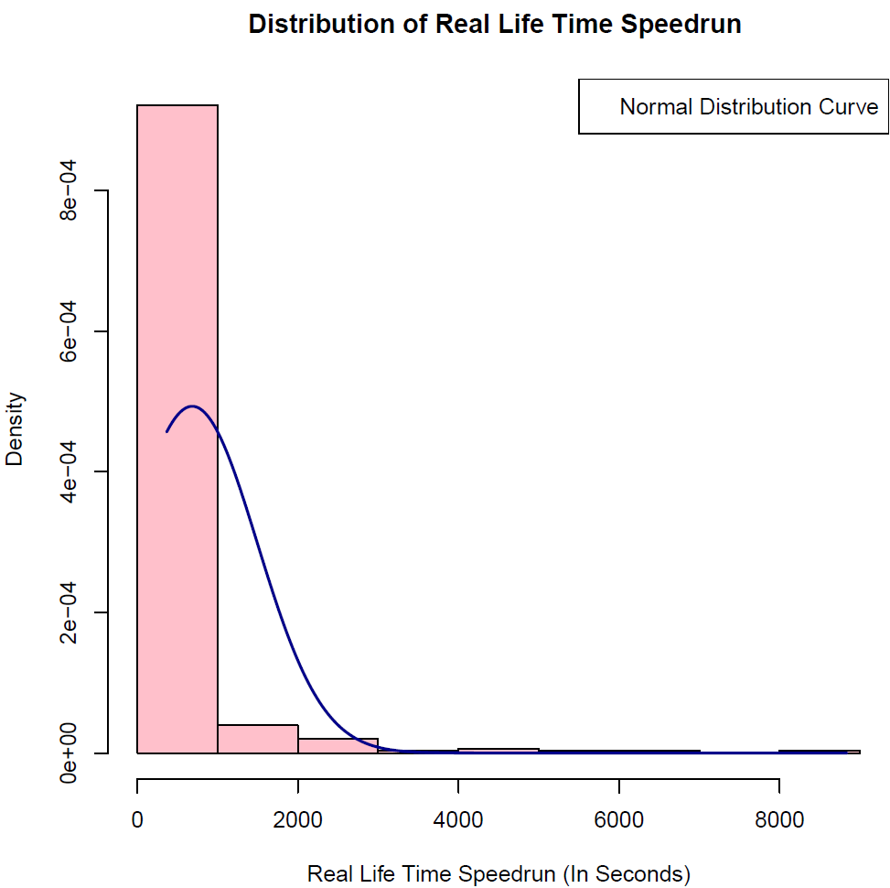
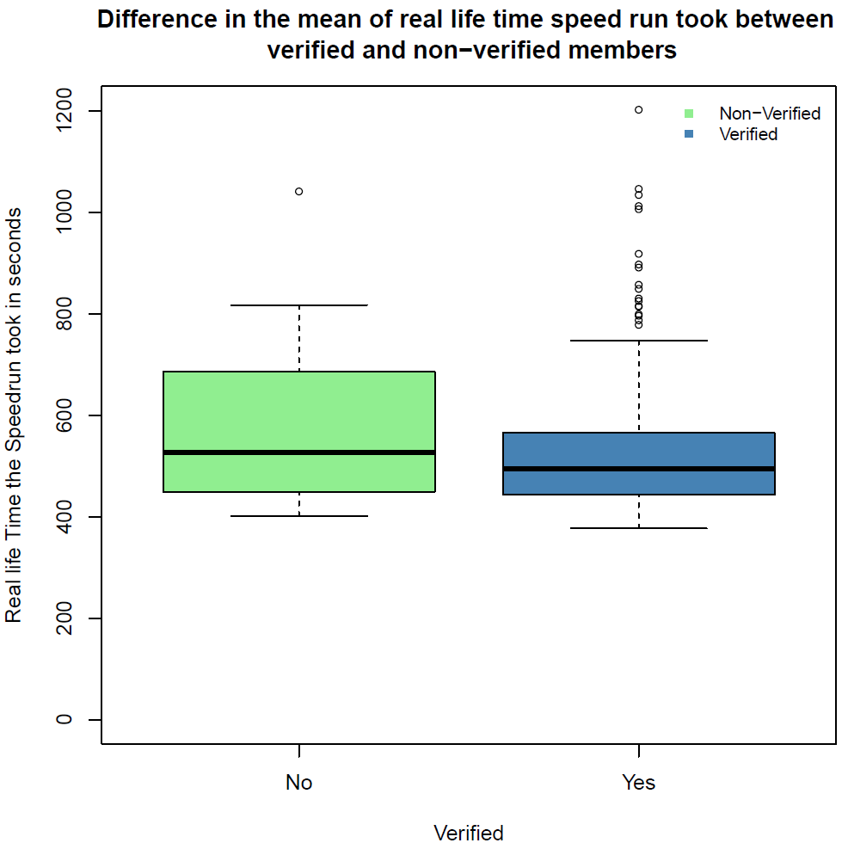
Here is a Histogram showing the frequencies of our dependent variable to include the normal curve overlay.
Our RQ asks about differences in means/ medians
The normal curve overlay does not follow the shape of the underlying data, as the distribution of real_time_seconds is heavily skewed with a long right tail. Therefore, we use the non-parametric test that does not assume normality: Wilcoxon rank sum test
2

Slide 3
R Script and Results (For ALL types of test) – The Analysis
PRE 7COM1079-2022 Student Group No: ?????
3
Wilcoxon rank sum test with continuity correction
data: data$real_time_seconds by data$verified
W = 3849, p-value = 0.2372
alternative hypothesis: true location shift is not equal to 0
P-value: The p-value is 0.2372, which is greater than 0.05
The result is not significant, as the p-value exceeds the threshold of 0.05.
We fail to reject the null hypothesis.
In the context of the research question, "Is there a difference in the mean of Verified between real_time_seconds?" this result indicates that there is no statistically significant evidence to suggest a difference in the mean of Verified values across different time intervals (real_time_seconds).
This means that real_time_seconds may not have a meaningful effect on Verified, or the dataset might lack the necessary power to detect a difference. Further investigation with a larger dataset or additional factors might be needed to draw more definitive conclusions.
Notes:
3

Slide 4
R Script
PRE 7COM1079-2022 Student Group No: ?????
4
boxplot(
real_time_seconds ~ verified,
data,
main = "Difference in the mean of real life time speed run took between \n verified and non-verified members",
xlab = "Verified",
ylab = "Real life Time the Speedrun took in seconds",
ylim = c(0, 1200),
pch = 1,
cex = 0.7,
col = c("lightgreen", "steelblue")
)
legend(
x = "topright",
legend = c("Non-Verified", "Verified"),
lwd = 2,
lty = c(0, 0),
bty = "n",
cex = 0.8,
inset = 0.01,
col = c("lightgreen", "steelblue"),
pch = c(15, 15)
)
hist(
data$real_time_seconds,
main = "Distribution of Real Life Time Speedrun ",
ylab = "Density",
xlab = "Real Life Time Speedrun (In Seconds)",
freq = FALSE,
col = "pink",
border = "black"
)
mean_value <- mean(data$real_time_seconds)
sd_value <- sd(data$real_time_seconds)
min_value <- min(data$real_time_seconds)
max_value <- max(data$real_time_seconds)
xvalue <- seq(min_value - 10, max_value + 10, length.out = 250)
yvalue <- dnorm(x = xvalue, mean = mean_value, sd = sd_value)
lines(xvalue, yvalue, type = "l", col = "darkblue", lwd = 2)
legend(
"topright", legend = "Normal Distribution Curve")
dev.off()
data$verified <- as.factor(data$verified)
# Wilcox test
wilcox.test(data$real_time_seconds ~ data$verified, exact = FALSE)
Notes:
4

